Slide 1
OmicCircos in R
Maarten Leerkes PhD

Slide 2
OmicCircos
This session describes OmicCircos parameter setting and tuning to construct circular plots with desired biological features. Example data from human, mouse, and bacteria genome will be used to demonstrate functions for the color selection, annotation, labeling, zoom, and integration of traditional plotting. Programming experience in R studio is required.
Features:
Data format
Installation
Basic plot setting
Advance parameter tuning
Integration of R statistics and plotting

Slide 3

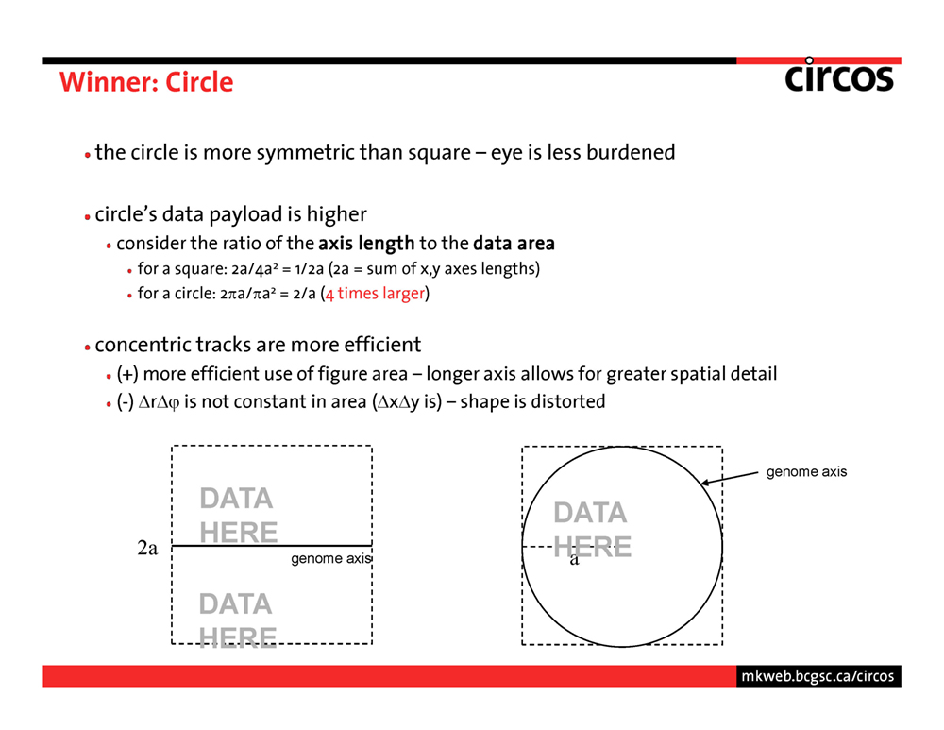

Slide 4
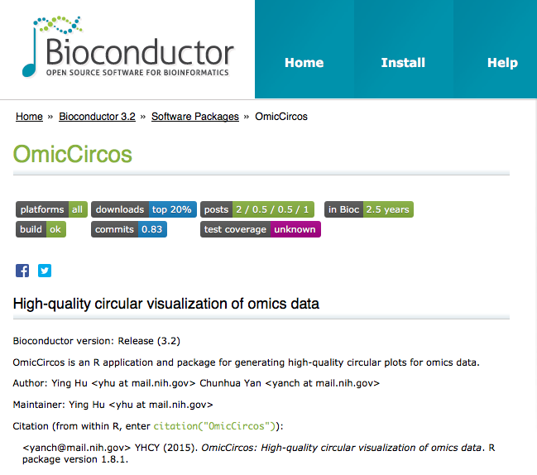
https://www.bioconductor.org/packages/release/bioc/html/OmicCircos.html

Slide 5
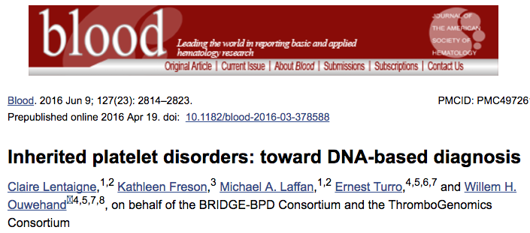
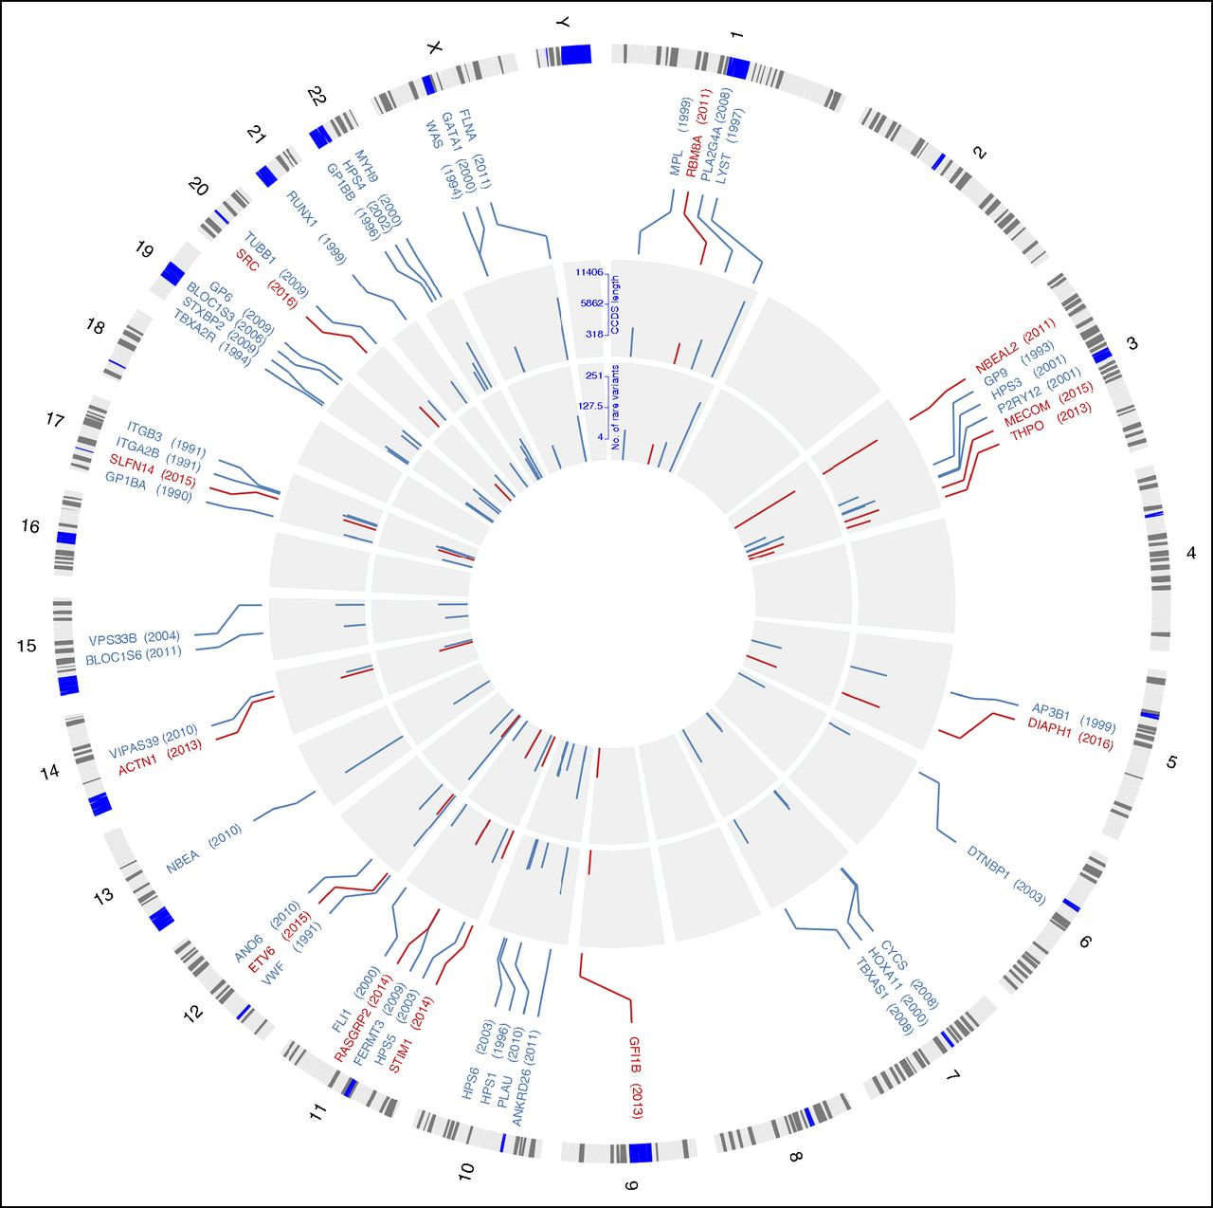
Wong VC, PLoS One. 2017; Zhao X, Front Microbiol. 2016; Pértille F, Sci Rep. 2016; Castro-Severyn J, Front Microbiol. 2017

Slide 6
OmicsCircos
Data format
Installation
Basic plot setting
Advance parameter tuning
Integration of R statistics and plotting

Slide 7
Data frames used in OmicCircos
Vectors
Matrices
Arrays
Data frames
Lists
Factors

Slide 8
genome
Input Data
Points
Links

Slide 9
OmicsCircos
Data format
Installation
Basic plot setting
Advance parameter tuning
Integration of R statistics and plotting

Slide 10



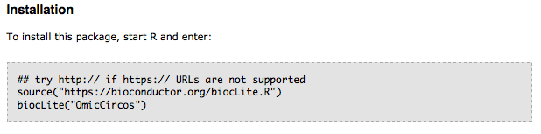
Prepare R environment
https://www.r-project.org
https://www.rstudio.com
https://www.bioconductor.org/packages/release/bioc/html/OmicCircos.html

Slide 11
OmicsCircos
Data format
Installation
Basic plot setting
Advance parameter tuning
Integration of R statistics and plotting

Slide 12
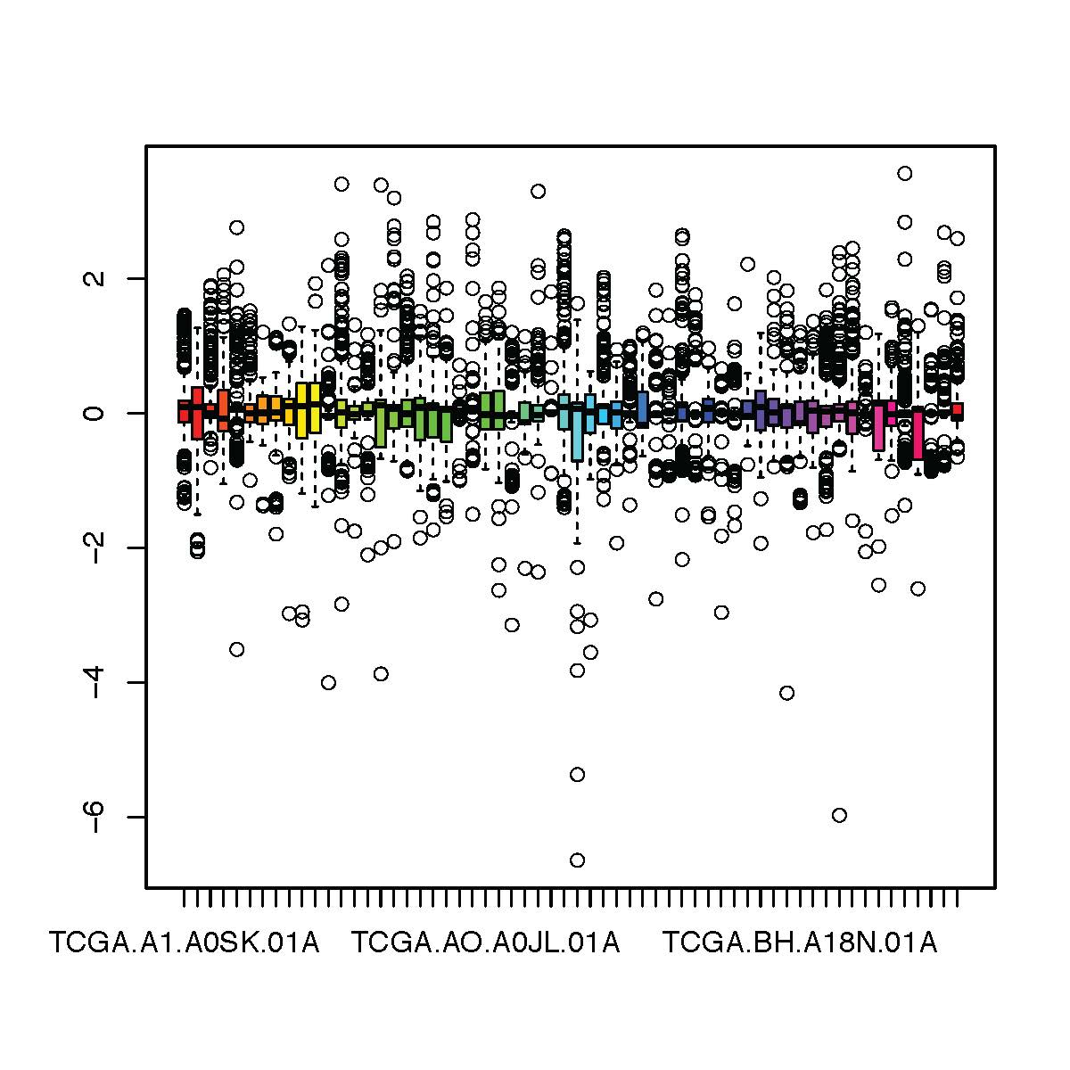
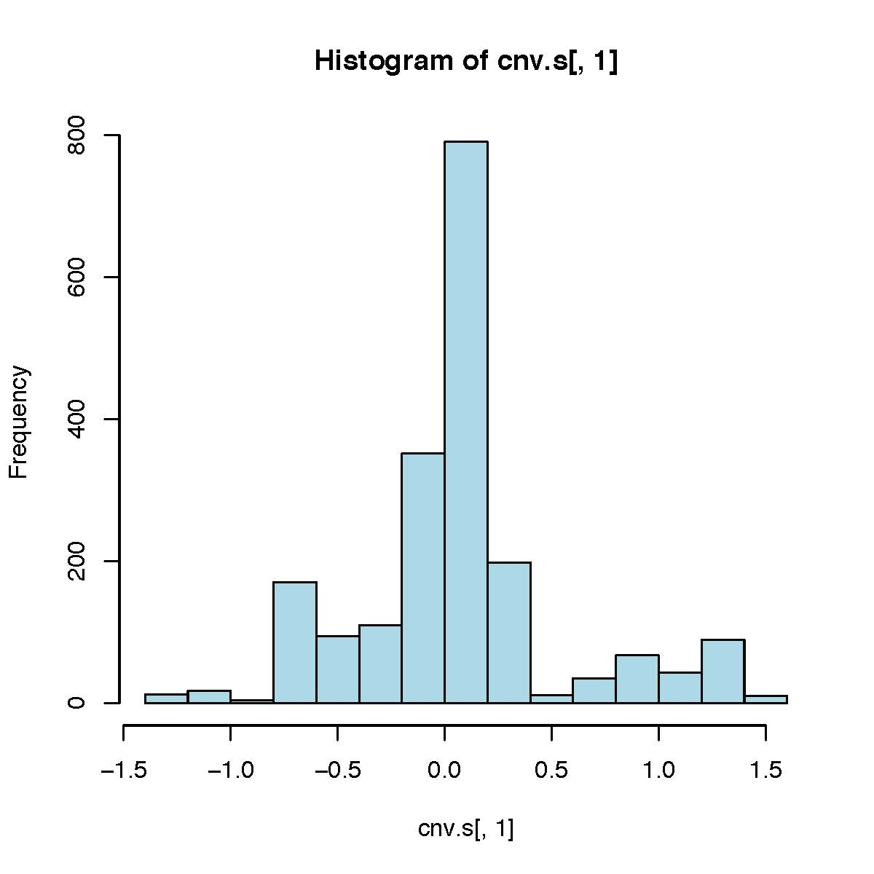
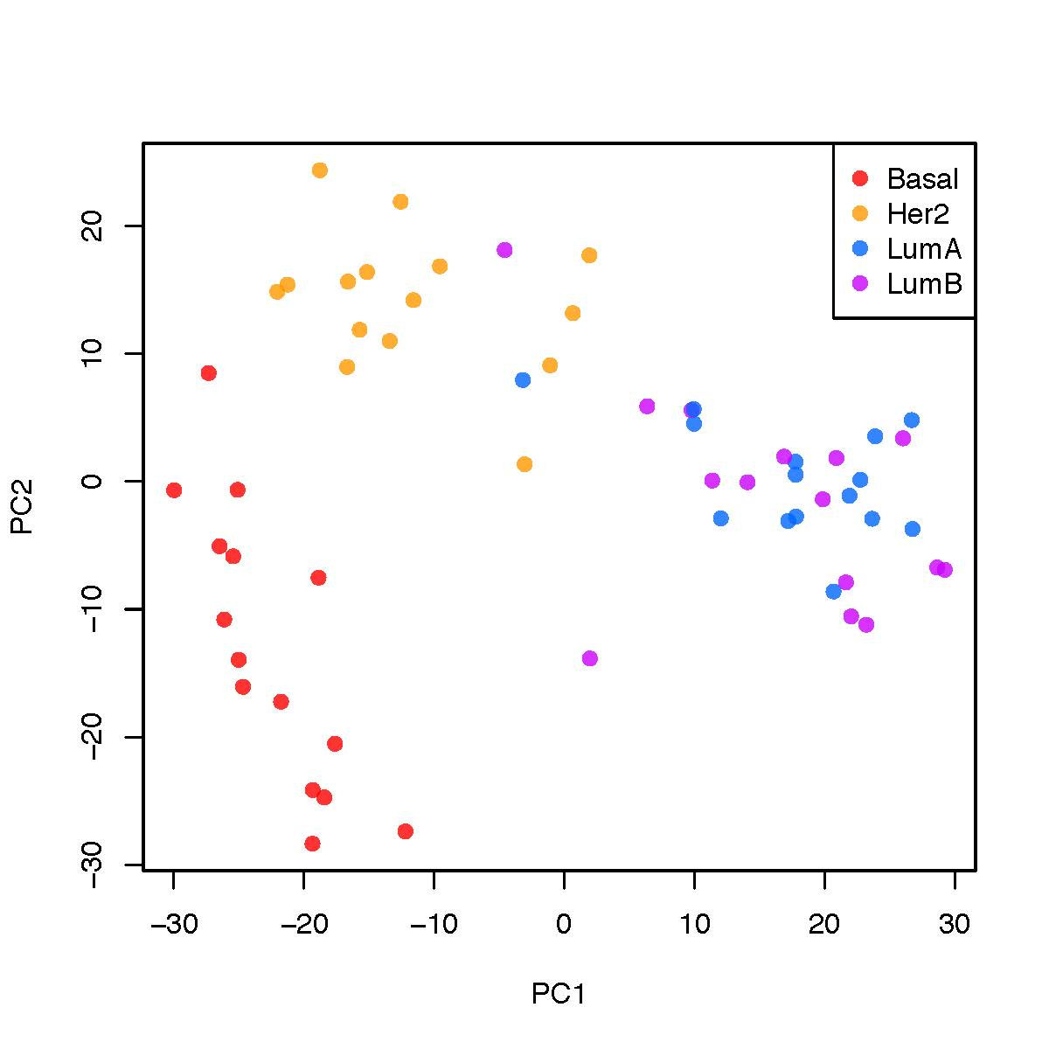
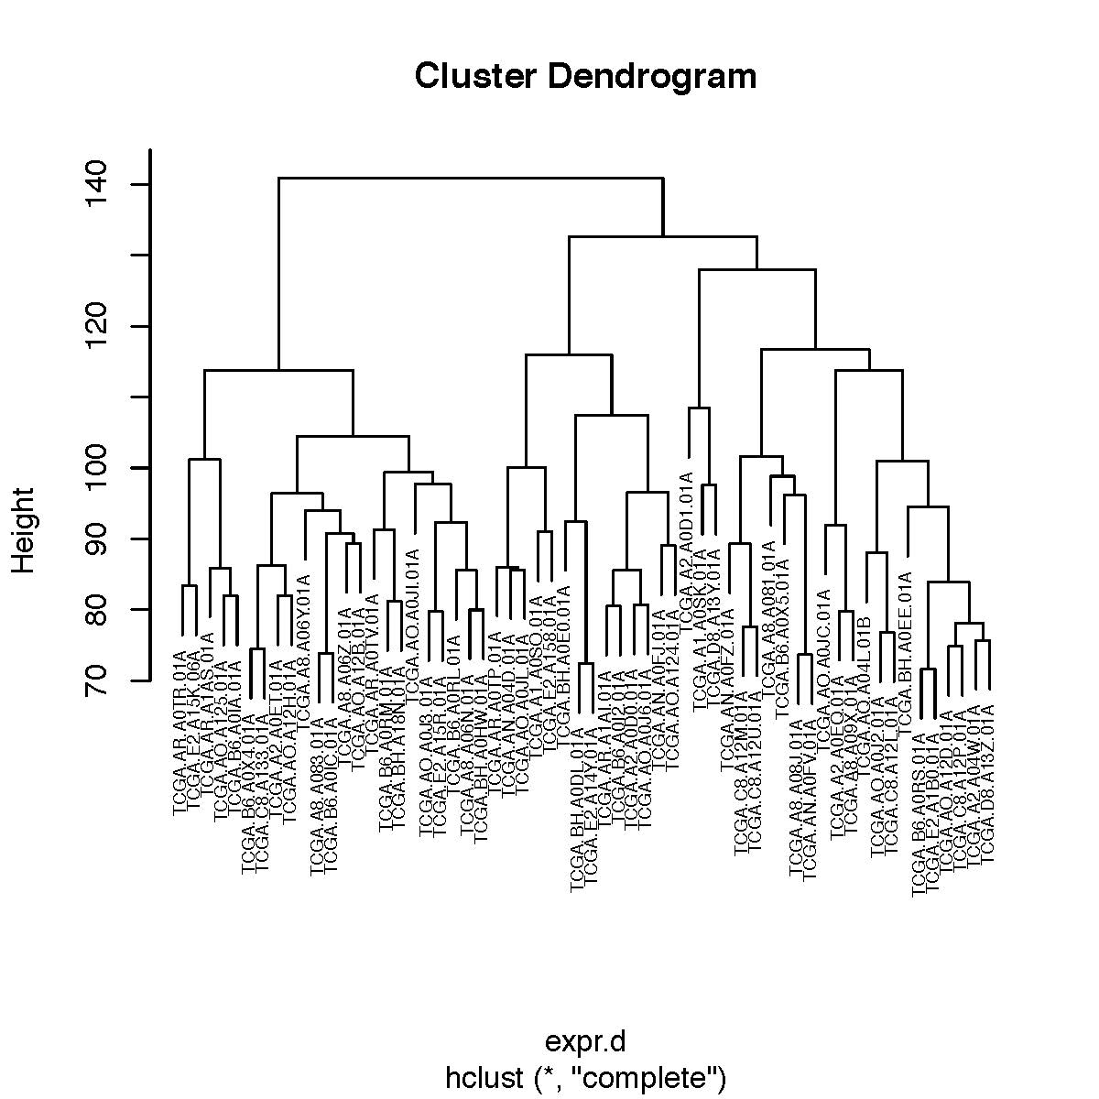
basic_plot_data_QC.R: QC plots
Set working directory
Load library
Check data
Table size
Data structure
Barplot
PCA plot
Cluster

Slide 13
basic_plot_line.R: line plots
"l": line
"ls": lines in stair step
"lh": horizontal lines
"ml": multiple lines (for more than 1 samples)
"ml2": multiple horizontal lines
"ml3": multiple lines in stair steps
"link": link lines based on Bezier curve
Notes:
Lh: copy number

Slide 14
basic_plot_variation.R: data stats
"quant90": 90% quantile lines
"sv": dot sizes proportional to the variance
"ss": dot sizes proportional to the values
"heatmap": heatmap
"s.sd": dots proportional to standard deviation
"ci95": 95% confidence interval line
"link": link lines based on Bezier curv
Notes:
Stats from R

Slide 15
basic_plot_arc.R: arc plots
"b3": bar charts with the same height
"s2": dots with the fixed radius
"arc2": arcs with the fixed radius
"b2": bi-directional bar charts
"arc": arcs with variable radius

Slide 16
basic_plot_label1/2.R: labels
"label": gene labels or text annotations

Slide 17
OmicsCircos
Data format
Installation
Basic plot setting
Advance parameter tuning
Integration of R statistics and plotting

Slide 18
advance_heatmap.R: heatmaps
"heatmap2": heatmaps with genomic coordinates, cluster, and color key

Slide 19
advance_user_genome.R: Ecoli
Define genome sizes
Create anchor circular location database

Slide 20
advance_zoom1/2.R: zoom

Slide 21
OmicsCircos
Data format
Installation
Basic plot setting
Advance parameter tuning
Integration of R statistics and plotting

Slide 22
integration_pca1/2.R: R graphics
Different integration of PCA and omicCircos plots

Slide 23
OmicsCircos
This session describes OmicCircos parameter setting and tuning to construct circular plots with desired biological features. Example data from human, mouse, and bacteria genome will be used to demonstrate functions for the color selection, annotation, labeling, zoom, and integration of traditional plotting. Programming experience in R studio is required.
Features:
Data format
Installation
Basic plot setting
Advance parameter tuning
Integration of R statistics and plotting

